Slide 1
あ行 (the a line)
a i u e o
あいうえお
How to remember each character？

Slide 2
か行 (the ka line)
Ka ki ku ke ko
かきくけこ
How to remember each character？

Slide 3
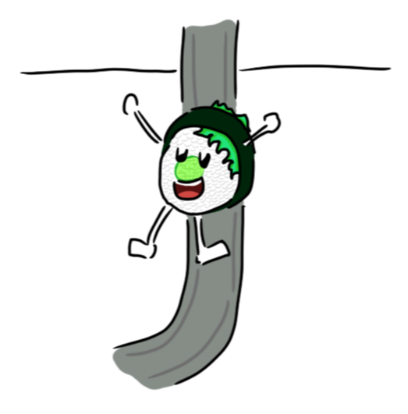
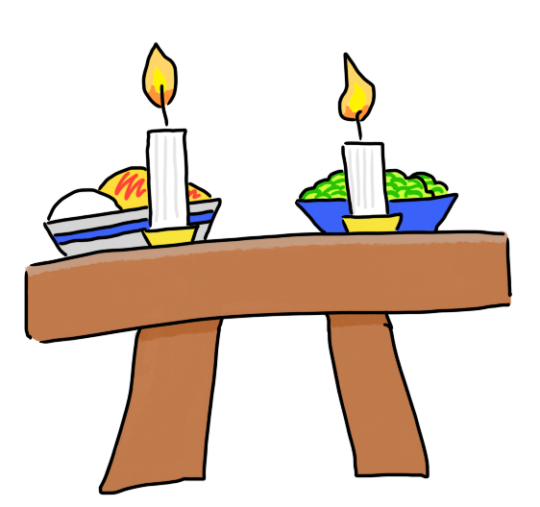
さ行 (the sa line)
sa shi su se so
さしすせそ

Slide 4
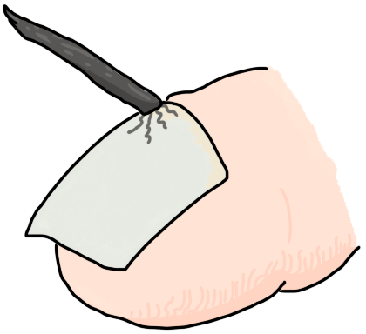
た行 (the ta line)
Ka ki ku ke ko
たちつてと

Slide 5
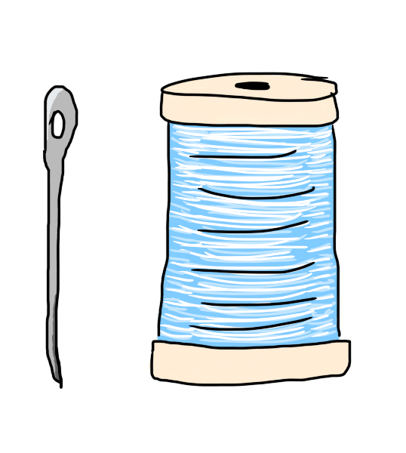
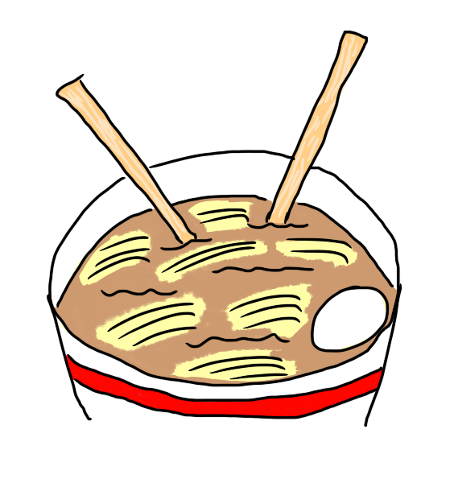
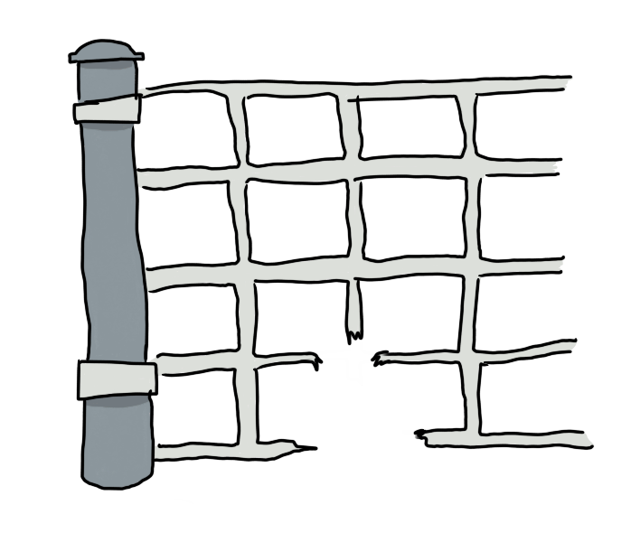
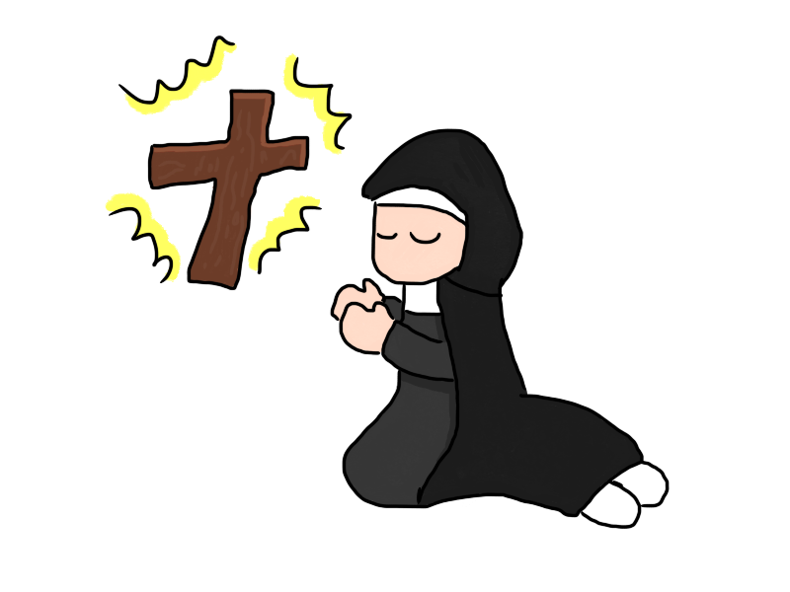
な行 (the na line)
NA NI NU NE NO
なにぬねの

Slide 6
は行 (the ha line)
HA HI FU HE HO
はひふへほ

Slide 7
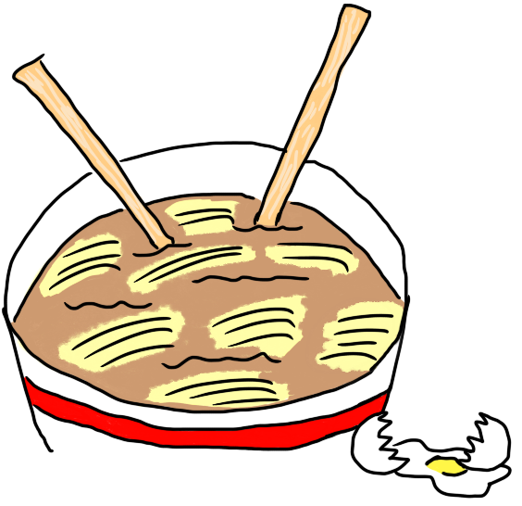
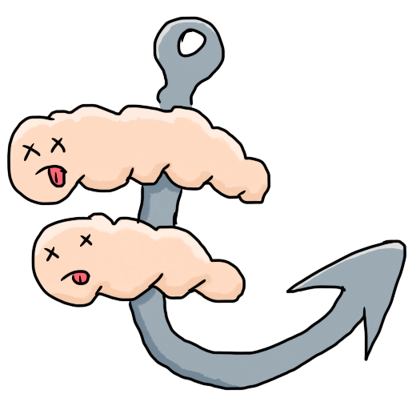
ま行 (the ma line)
MA MI MU ME MO
まみむめも

Slide 8
や行 (the ya line)
YA -- YU -- YO
や・ゆ・よ

Slide 9
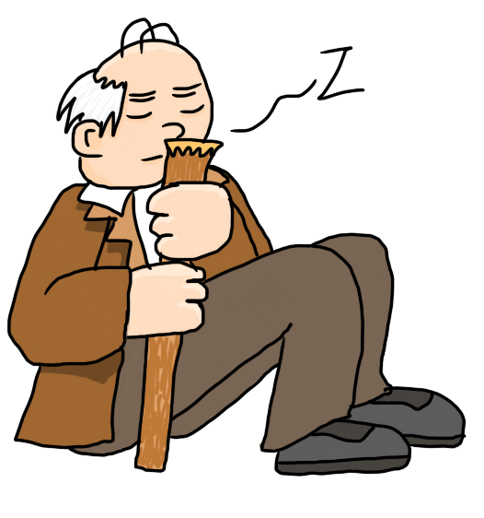
ら行 (the ra line)
RA RI RU RE RO
らりるれろ

Slide 10
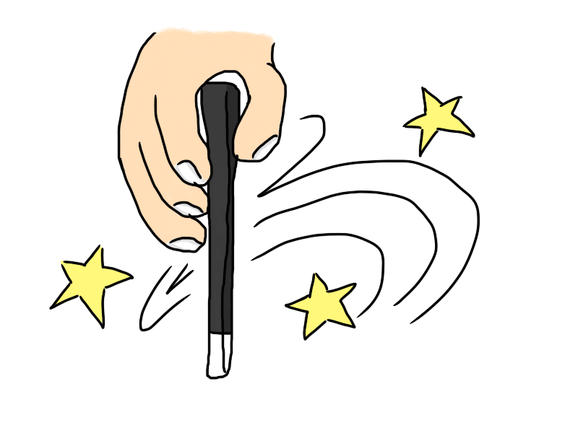
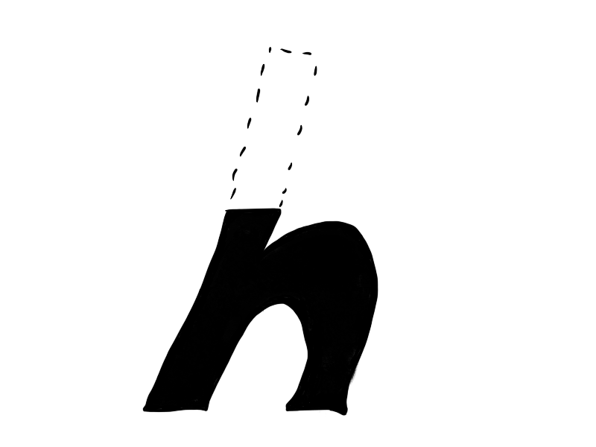
わ行 (the wa line)
WA -- WO -- N
わ・を・ん

